Slide 1
Convolutional autoencoder-based SOH estimation of lithium-ion batteries using electrochemical impedance spectroscopy
台灣科技大學 AI所
指導教授： | 羅一峰 博士
學生： | 林志龍
Journal of Energy Storage 60 (2023) 106680

Slide 2
Outline
Introduction
Objectives & Contributions
Data Preprocessing
Model Architecture (CAE-DNN)
Experimental Setup
Result
Discussion and Conclusion
Critical Review / Future Work

Slide 3
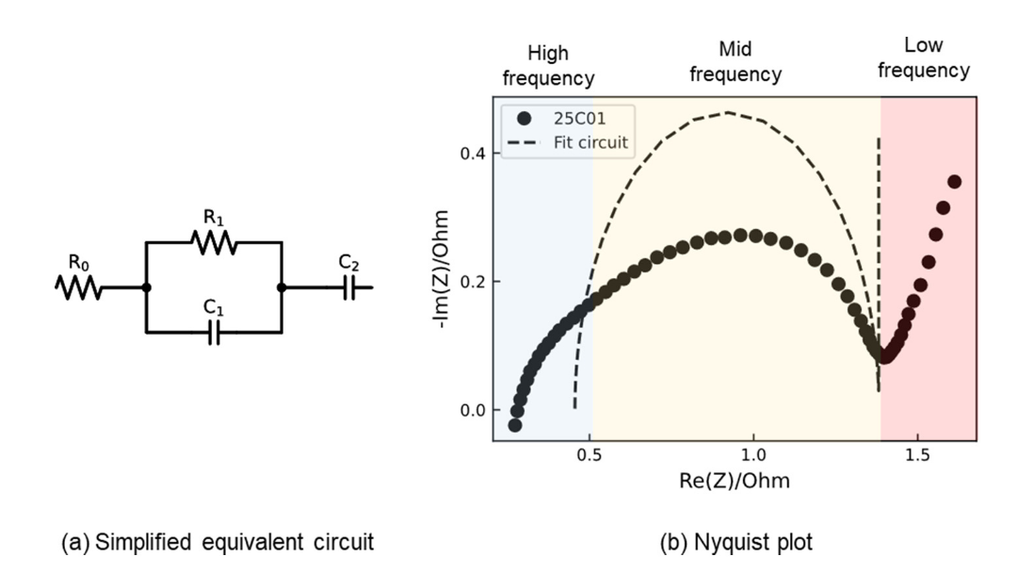
Introduction
Limited Scope: Most existing reviews focus solely on single-cell estimation.
Crucial Role of Li-ion Batteries:
Li-ion batteries are central to EVs and consumer electronics, requiring accurate State-of-Health (SOH) monitoring for safety and longevity.
Limitations of Traditional Methods?
Equivalent Circuit Models (ECMs): Rely on constructing physical circuit models which require complex parameter identification.
Manual Feature Extraction: Methods like Gray analysis or SVD are time-consuming and prone to human error .
The Gap: There is a need for an automatic method that doesn't rely on pre-defined physical models.

Slide 4
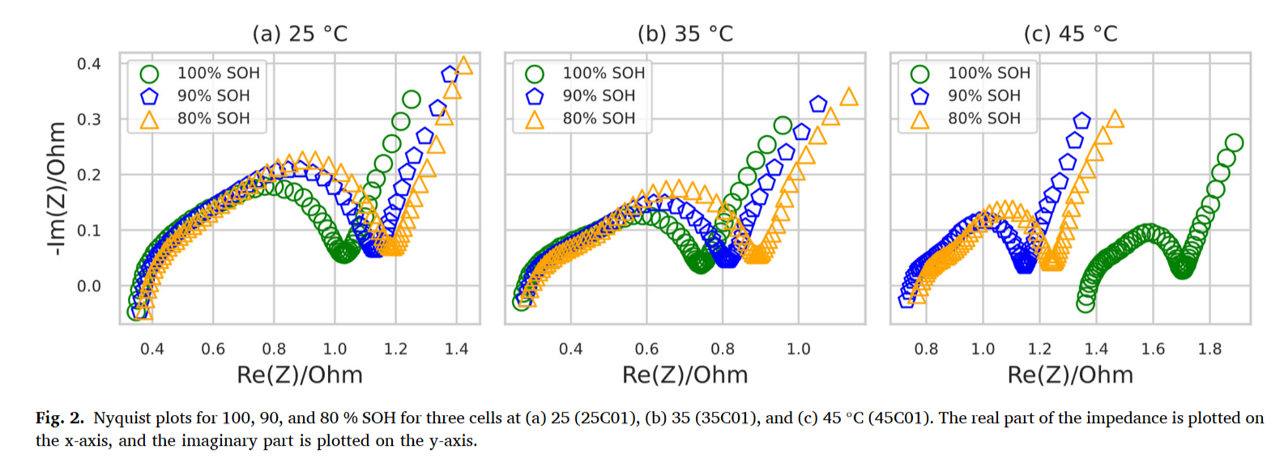
Introduction
Why use EIS Data?:
EIS (Electrochemical Impedance Spectroscopy) sees "inside" the battery .
As shown in Fig. 2: The graph changes clearly when SOH drops (from 100% to 80%) .
This makes it great for tracking battery health.
Our Solution: Deep Learning?
We use a model called CAE (Convolutional Autoencoder).
It learns features automatically from EIS data.
Benefit: No need for manual calculation or physical models.

Slide 5
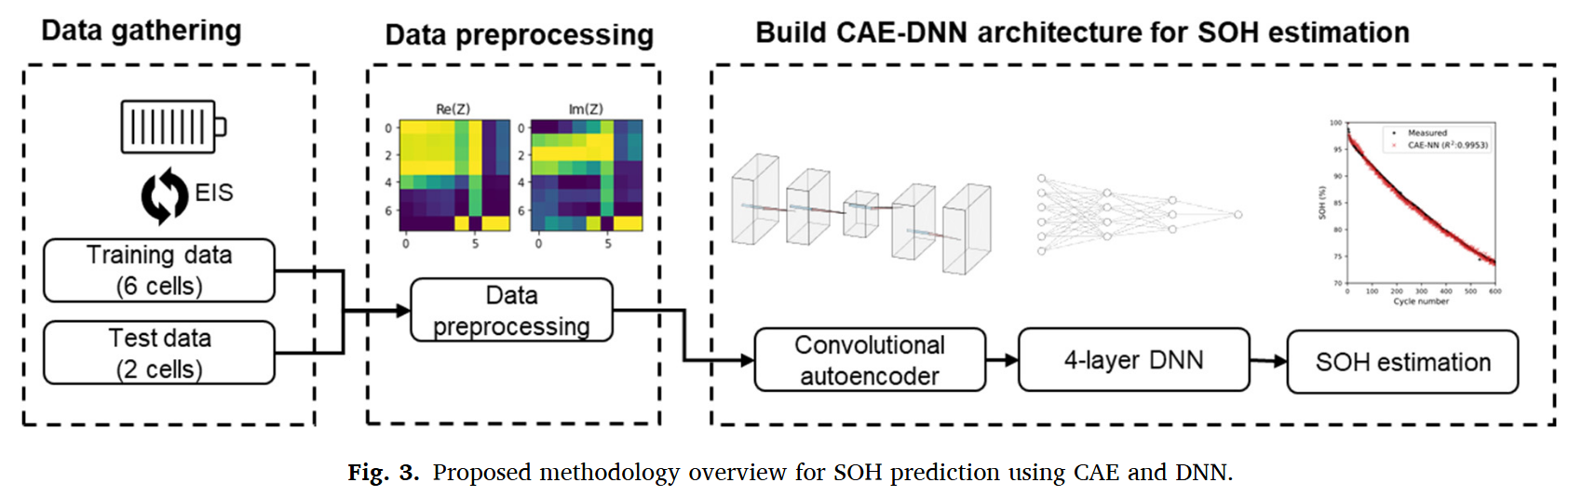
Objectives & Contributions
Main Objective:
To build a Deep Learning model (CAE-DNN) for SOH estimation using only EIS data.
Our Key Innovations?
New Data Format: We transform raw EIS data into 2D Images to work better with AI.
Automatic Learning: We use an Autoencoder to extract features automatically. No need for manual calculation or labeling .

Slide 6
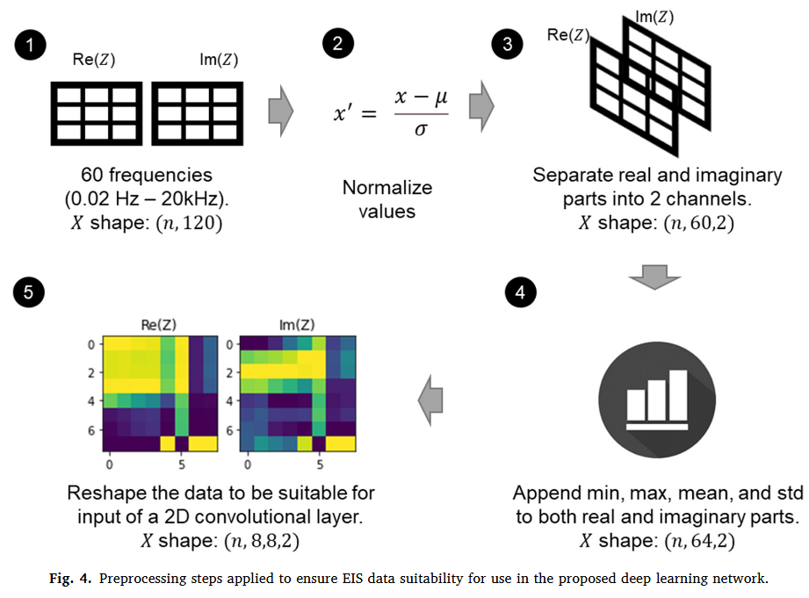
Data Preprocessing
Transforming Data into "Images"
Raw Data Input:
We measure impedance (Z) at 60 different frequencies.
Total 120 values (Real and Imaginary parts).
Key Steps
Normalize: Scale the values to make them easy to learn.
Add Statistics: We add 4 values (Min, Max, Mean, Std) to give more information.
Reshape to 2D: We turn the data into an 8x8 matrix.
Result
The data becomes a 2D Image with 2 channels (Real & Imaginary).

Slide 7
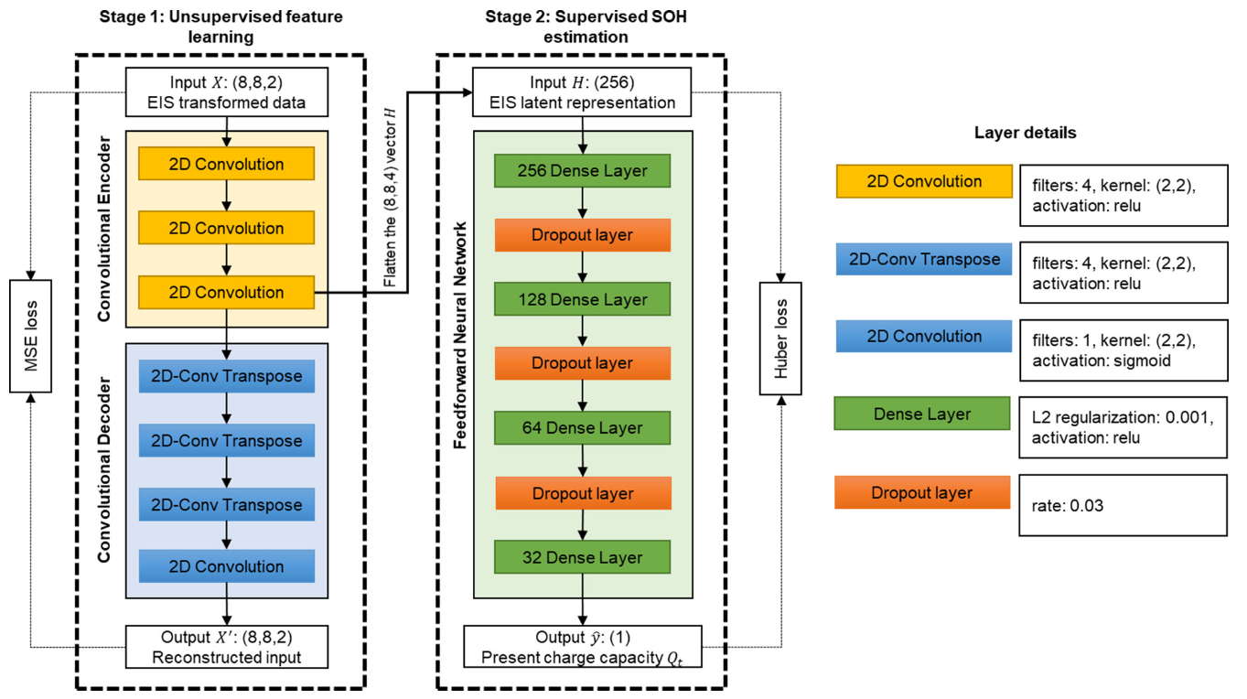
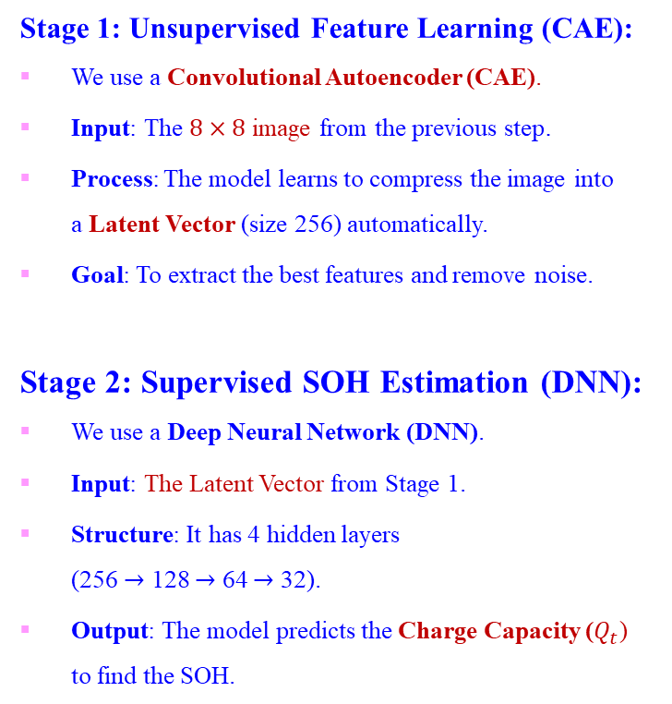
Model Architecture (CAE-DNN)
A Two-Stage Deep Learning Model
Stage 1: Unsupervised Feature Learning (CAE):
We use a Convolutional Autoencoder (CAE).
Input: The $8×8$ image from the previous step.
Process: The model learns to compress the image into a Latent Vector (size 256) automatically.
Goal: To extract the best features and remove noise.
Stage 2: Supervised SOH Estimation (DNN):
We use a Deep Neural Network (DNN).
Input: The Latent Vector from Stage 1.
Structure: It has 4 hidden layers (256 $→$ 128 $→$ 64 $→$ 32).
Output: The model predicts the Charge Capacity ($Q_{t}$) to find the SOH.

Slide 8
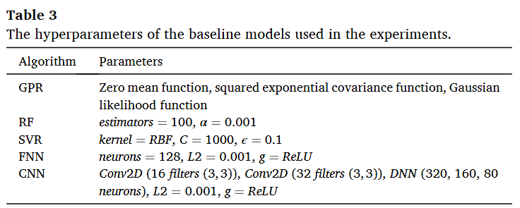
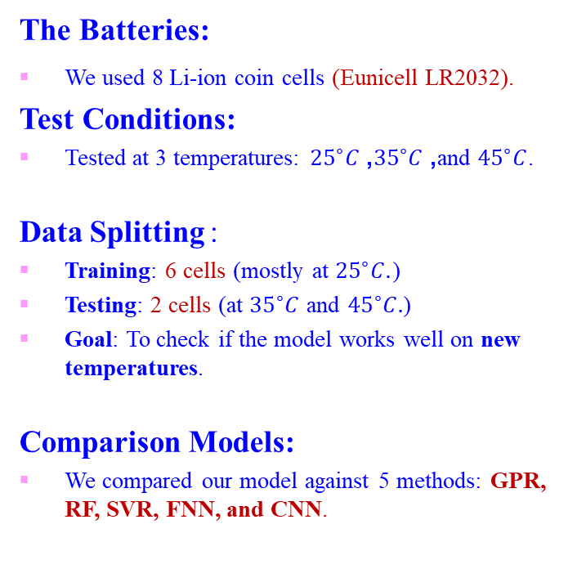
Experimental Setup
The Batteries:
We used 8 Li-ion coin cells (Eunicell LR2032).
Test Conditions:
Tested at 3 temperatures: ${25}^{∘}C$, ${35}^{∘}C$, and ${45}^{∘}C$.
Data Splitting :
Training: 6 cells (mostly at ${25}^{∘}C$.)
Testing: 2 cells (at ${35}^{∘}C$ and ${45}^{∘}C.$)
Goal: To check if the model works well on new temperatures.
Comparison Models:
We compared our model against 5 methods: GPR, RF, SVR, FNN, and CNN.

Slide 9
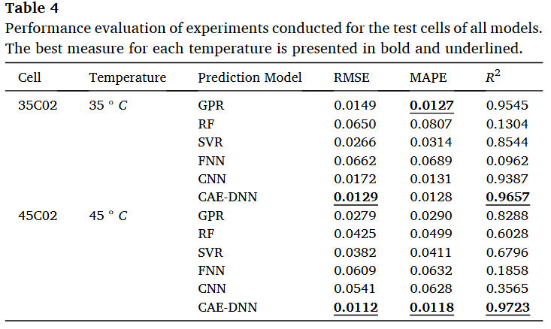
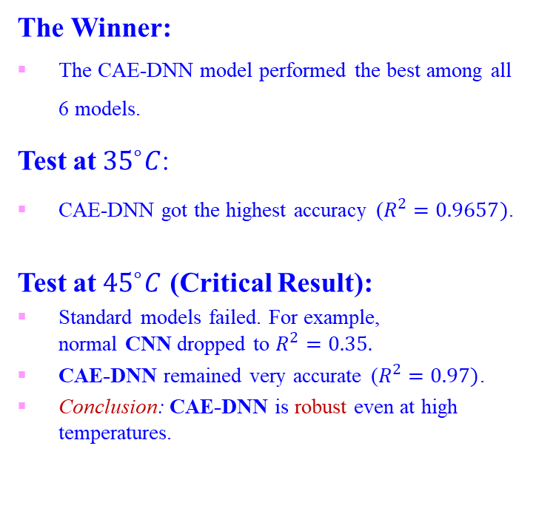
Result Quantitative
The Winner:
The CAE-DNN model performed the best among all 6 models.
Test at ${35}^{∘}C$:
CAE-DNN got the highest accuracy ($R^{2}=0.9657)$.
Test at ${45}^{∘}C$ (Critical Result):
Standard models failed. For example, normal CNN dropped to $R^{2}=0.35$.
CAE-DNN remained very accurate ($R^{2}=0.97)$.
Conclusion: CAE-DNN is robust even at high temperatures.

Slide 10
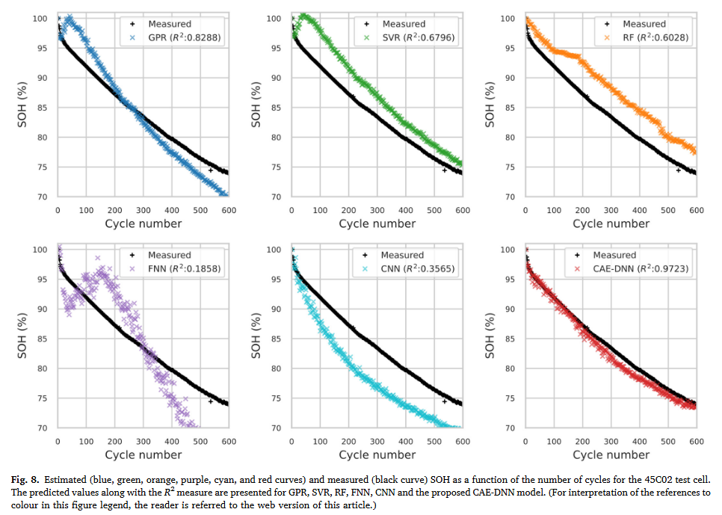

Result Visual
Test at ${45}^{∘}C$

Slide 11
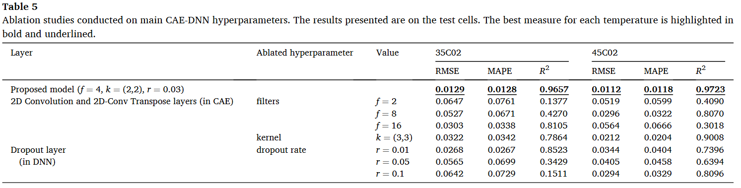
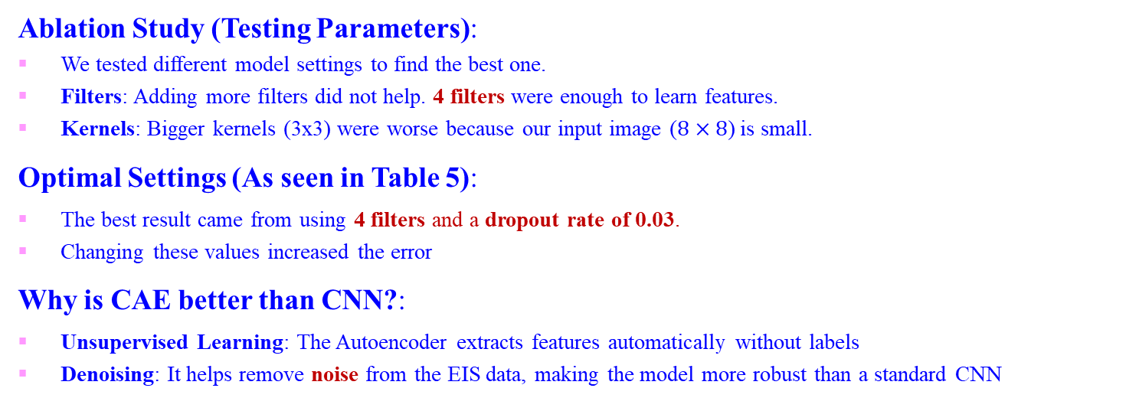
Discussion and Conclusion
Ablation Study (Testing Parameters):
We tested different model settings to find the best one.
Filters: Adding more filters did not help. 4 filters were enough to learn features.
Kernels: Bigger kernels (3x3) were worse because our input image ($8×8$) is small.
Optimal Settings (As seen in Table 5):
The best result came from using 4 filters and a dropout rate of 0.03.
Changing these values increased the error
Why is CAE better than CNN?:
Unsupervised Learning: The Autoencoder extracts features automatically without labels
Denoising: It helps remove noise from the EIS data, making the model more robust than a standard CNN

Slide 12

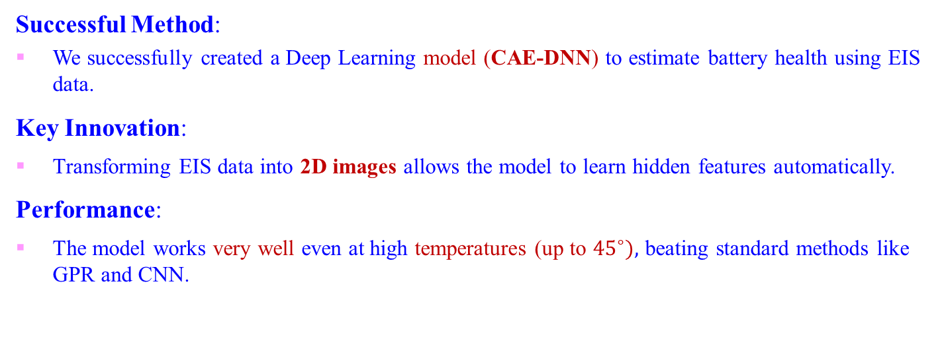
Discussion and Conclusion
Successful Method:
We successfully created a Deep Learning model (CAE-DNN) to estimate battery health using EIS data.
Key Innovation:
Transforming EIS data into 2D images allows the model to learn hidden features automatically.
Performance:
The model works very well even at high temperatures (up to ${45}^{∘}),$ beating standard methods like GPR and CNN.

Slide 13
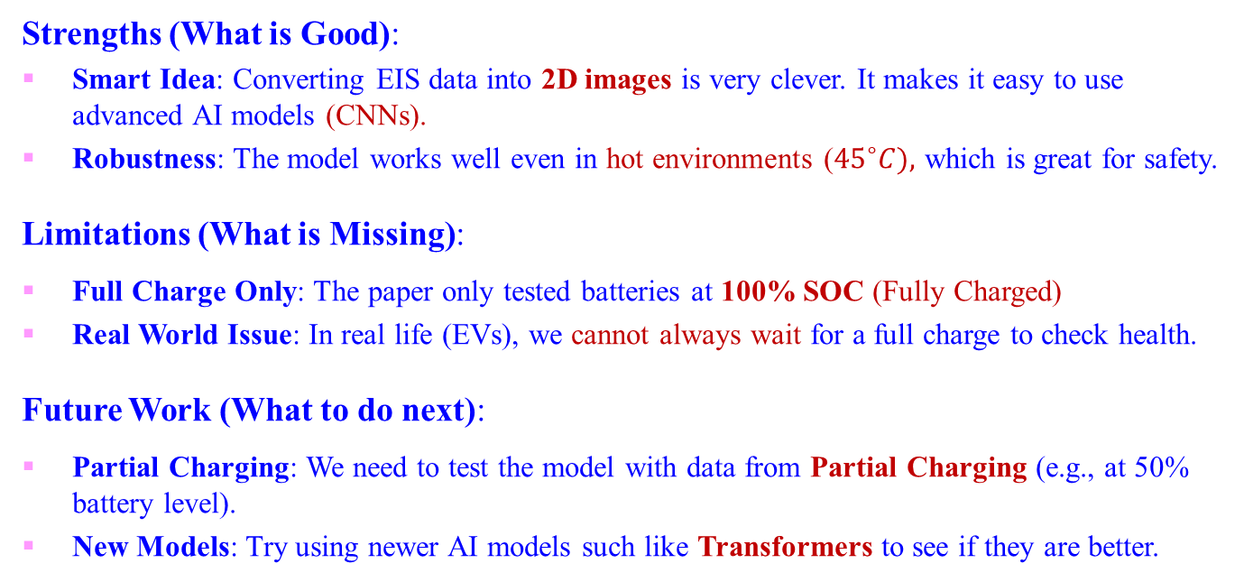
Critical Review & Future Work
Strengths (What is Good):
Smart Idea: Converting EIS data into 2D images is very clever. It makes it easy to use advanced AI models (CNNs).
Robustness: The model works well even in hot environments (${45}^{∘}C),$ which is great for safety.
Limitations (What is Missing):
Full Charge Only: The paper only tested batteries at 100% SOC (Fully Charged)
Real World Issue: In real life (EVs), we cannot always wait for a full charge to check health.
Future Work (What to do next):
Partial Charging: We need to test the model with data from Partial Charging (e.g., at 50% battery level).
New Models: Try using newer AI models such like Transformers to see if they are better.

Slide 14
Journal of Energy Storage 60 (2023) 106680
Strength: Low computational complexity; excellent for real-time BMS updates.
Thank you
Notes:
實驗平台由 Arbin 的 LBT 系列 電池充放電測試儀、高低溫試驗箱，以及一台主控電腦組成

